Slide 1
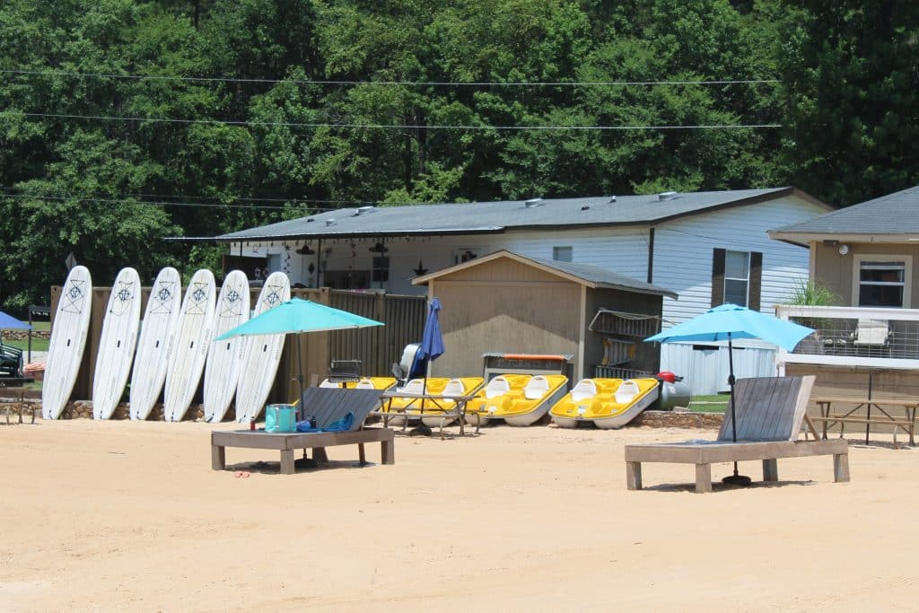
Your Tax Dollars at Work
A Financial Report to the Citizens of
Putnam County, Georgia
for Fiscal Year 2024
October 1, 2023 – September 30, 2024
Photo Courtesy of Visit Eatonton

Slide 2
ABOUT THIS REPORT
On behalf of Putnam County Board of Commissioners, we are pleased to present our nineth Popular Annual Financial Report (PAFR) for the year ended September 30, 2024. Like the U.S. Government and State of Georgia, Putnam County runs its budget on a “fiscal year,” from October 1 to September 30. The purpose of this report is to provide readers with an overview of the County, its different departments, and financial information. However, it does not provide information regarding Funds or Component Units.
As part of the county’s commitment to be transparent to its citizens, the report will also provide an overview of the county’s organizational structure, services offered to its citizens, and financial state. The information in this report is extracted from the County’s Annual Comprehensive Financial Report, which gives further detailed information.
Click the links provided to view Putnam County’s 2024 Annual Comprehensive Financial Report and 2023 Popular Annual Financial Report .

Slide 3
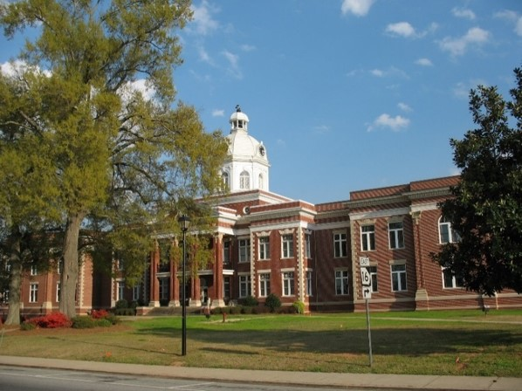
Table of Contents
Cover
About This Report
Table of Contents
Our Commissioners
Our Mission and Purpose
Letter from Our County Manager
Well-Known Connections
Award for Outstanding Achievement in Popular Annual Financial Reporting
Organization
Putnam County EMS
Putnam County Fire-Rescue
Putnam County Animal Services
Uncle Remus Golf Course
Putnam County Recreation
Financial Information
15. Net Position
16. Assets
17. Glossary of Terms

Slide 4
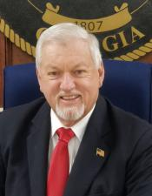
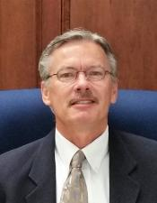
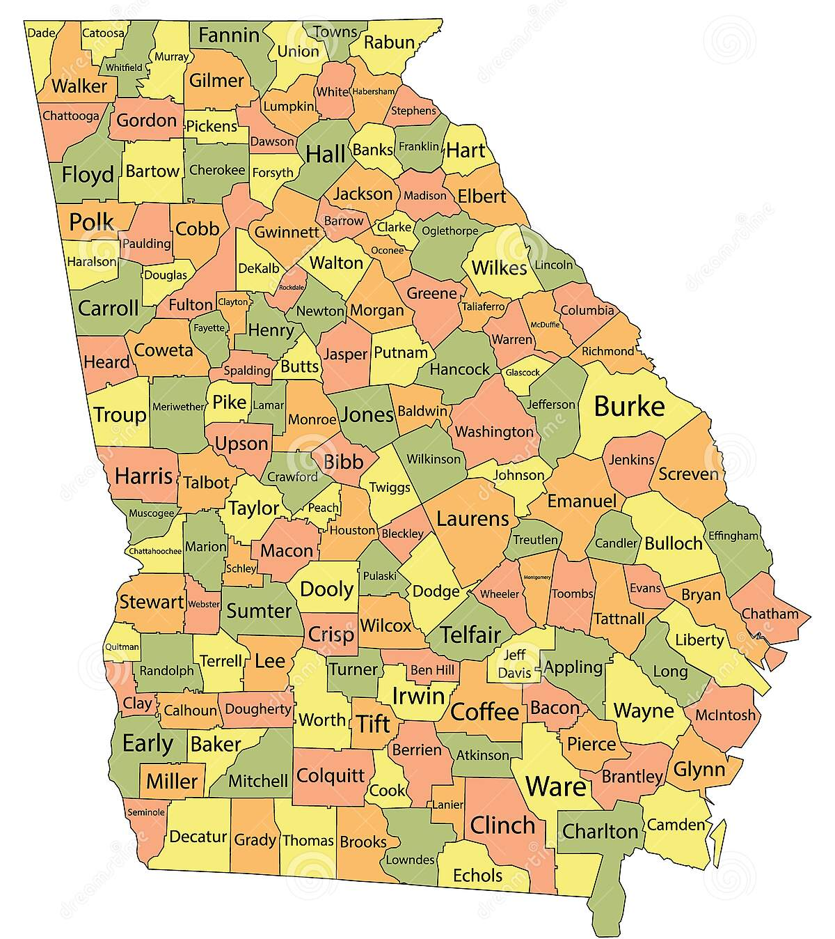
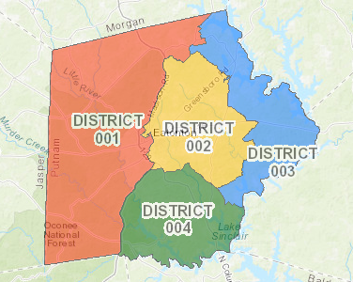
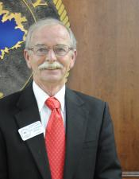
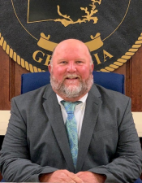
Our County, Commissioners, and Districts
The Board of Commissioners is a policy making body that oversees the executive functions of the county and assigns the day-to-day duties of the executive role to the county manager.
Bordered by Morgan, Greene, Hancock, Baldwin, Jones, and Jasper Counties, Putnam County is in Central Georgia.
Bill Sharp
Chairman
Vacant
District 1
Daniel W. Brown
District 2
Stephen Hersey
District 3
Jeff Wooten
Vice Chairman and District 4

Slide 5

Our Mission and Purpose
“The mission of Putnam County government is to provide courteous, responsive, innovative and cost-effective services.”
Putnam County government exists to:
P – Properly administer the affairs of Putnam County
U – Understand we must maintain a high level of professionalism
T – Transparency will be paramount without exception
N – Nonpartisanship with the understanding that all voices must be heard
A – Actively promote public confidence in county government
M – Maintain a positive image

Slide 6
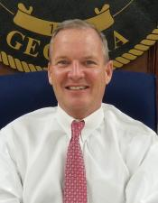
To the Greatest Citizens of the Greatest County in Georgia:
On behalf of the Putnam County Staff, I am pleased to present our Popular Annual Financial Report (PAFR) for the fiscal year ended September 30, 2024. This report is designed to increase awareness throughout our county relative to the financial operations of Putnam County and provide you with information on how your tax dollars are managed.
The financial information within this report is derived, in large part, from Putnam County’s independently audited set of financial statements that are prepared in accordance with the Generally Accepted Accounting Principles (GAAP). The information is part of the County’s 2024 Annual Comprehensive Financial Report. We are proud to say that our efforts regarding the County’s Annual Comprehensive Financial Report have earned Putnam County’s Finance Department the Certificate of Achievement for Excellence in Reporting by the Government Finance Officers Association for the past eleven years.
I am very proud of all that has been accomplished in the past year. The Board of Commissioners and staff strive to provide the highest and best possible services at the least possible cost. There is a lot of positive news in Putnam County and the following are some of the highlights.
The county experienced exceptionally good financial news this year. Moody’s reaffirmed their Aa3 rating of Putnam County in 2024. There has been a resurgence in residential and commercial activity. The County Building Permit activity and LOST collections increased again this year, both of which are very positive signs for our local economy. Thanks to your approval of TSPLOST#2, the county has embarked on another five-year road paving and improvement program.
There is much more happening in Putnam County, and we are looking forward to sharing those successes with you in the months and years to come. Your commissioners, staff, and I thank you for your continued trust and faith in us. We are proud to report to you that, as the economy continues to improve, so will Putnam County.
Sincerely,
Paul Van Haute
County Manager
Paul Van Haute
County Manager

Slide 7
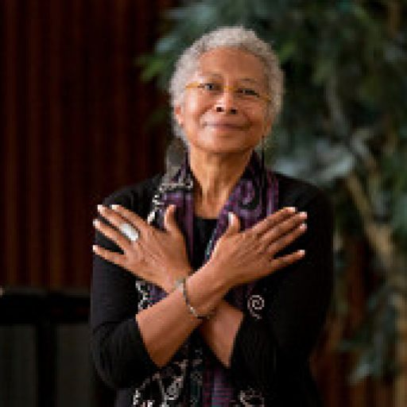
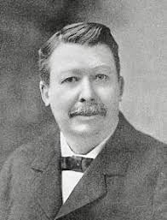

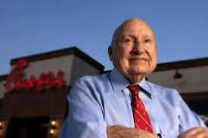
Putnam County has a rich history with several well-known connections. Our county is named after General Israel Putnam, a hero of the Revolutionary War. William H. Seward, a Secretary of State under President Abraham Lincoln, served as rector for Eatonton’s first school known as Eatonton Academy.
Some of our other well-known connections are also pictured here. Maybe you’ve heard of them?
Pulitzer Prize Winning Author and Women’s Rights Activist, Alice Walker, was born in Putnam County.
Joel Chandler Harris, fiction writer and folklorist, was born in Putnam County.
Vincent Hancock, three-time Olympic gold medalist, grew up in Putnam County.
Truett Cathy, founder and chairman emeritus of Chick-fil-A, was born in Putnam County.

Slide 8
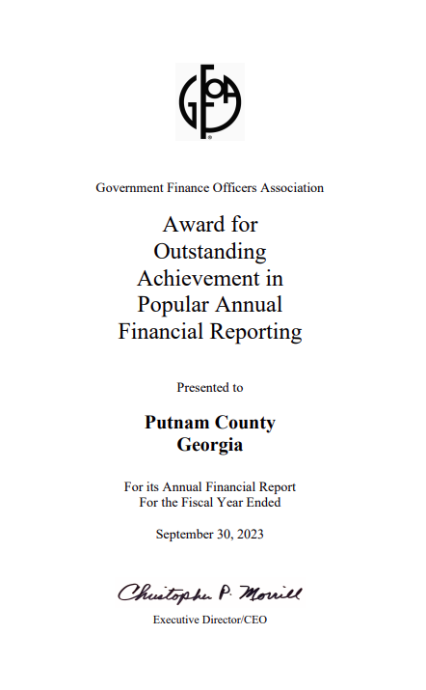
Award for Outstanding Achievement in Popular Annual Financial Reporting
Government Finance Officers Association of the United States and Canada (GFOA) has given an Award for Outstanding Achievement in Popular Annual Financial Reporting to Putnam County Government for its Popular Annual Financial Report for the fiscal year ended September 30, 2023. The Award for Outstanding Achievement in Popular Financial Reporting is a prestigious national award recognizing conformance with the highest standards for preparation of state and local government popular reports.
In order to receive an Award for Outstanding Achievement in Popular Financial Reporting, a government unit must publish a Popular Annual Financial Report, whose contents conform to program standards of creativity, presentation, understandability, and reader appeal.
An Award for Outstanding Achievement in Popular Annual Financial Reporting is valid for a period of one year only. Putnam County Government has received a Popular Award for the last nine consecutive years (fiscal years ended 2015 – 2023). We believe our current report continues to conform to the Popular Annual Financial Reporting requirements, and we are submitting it to GFOA to determine its eligibility for another Award.

Slide 9
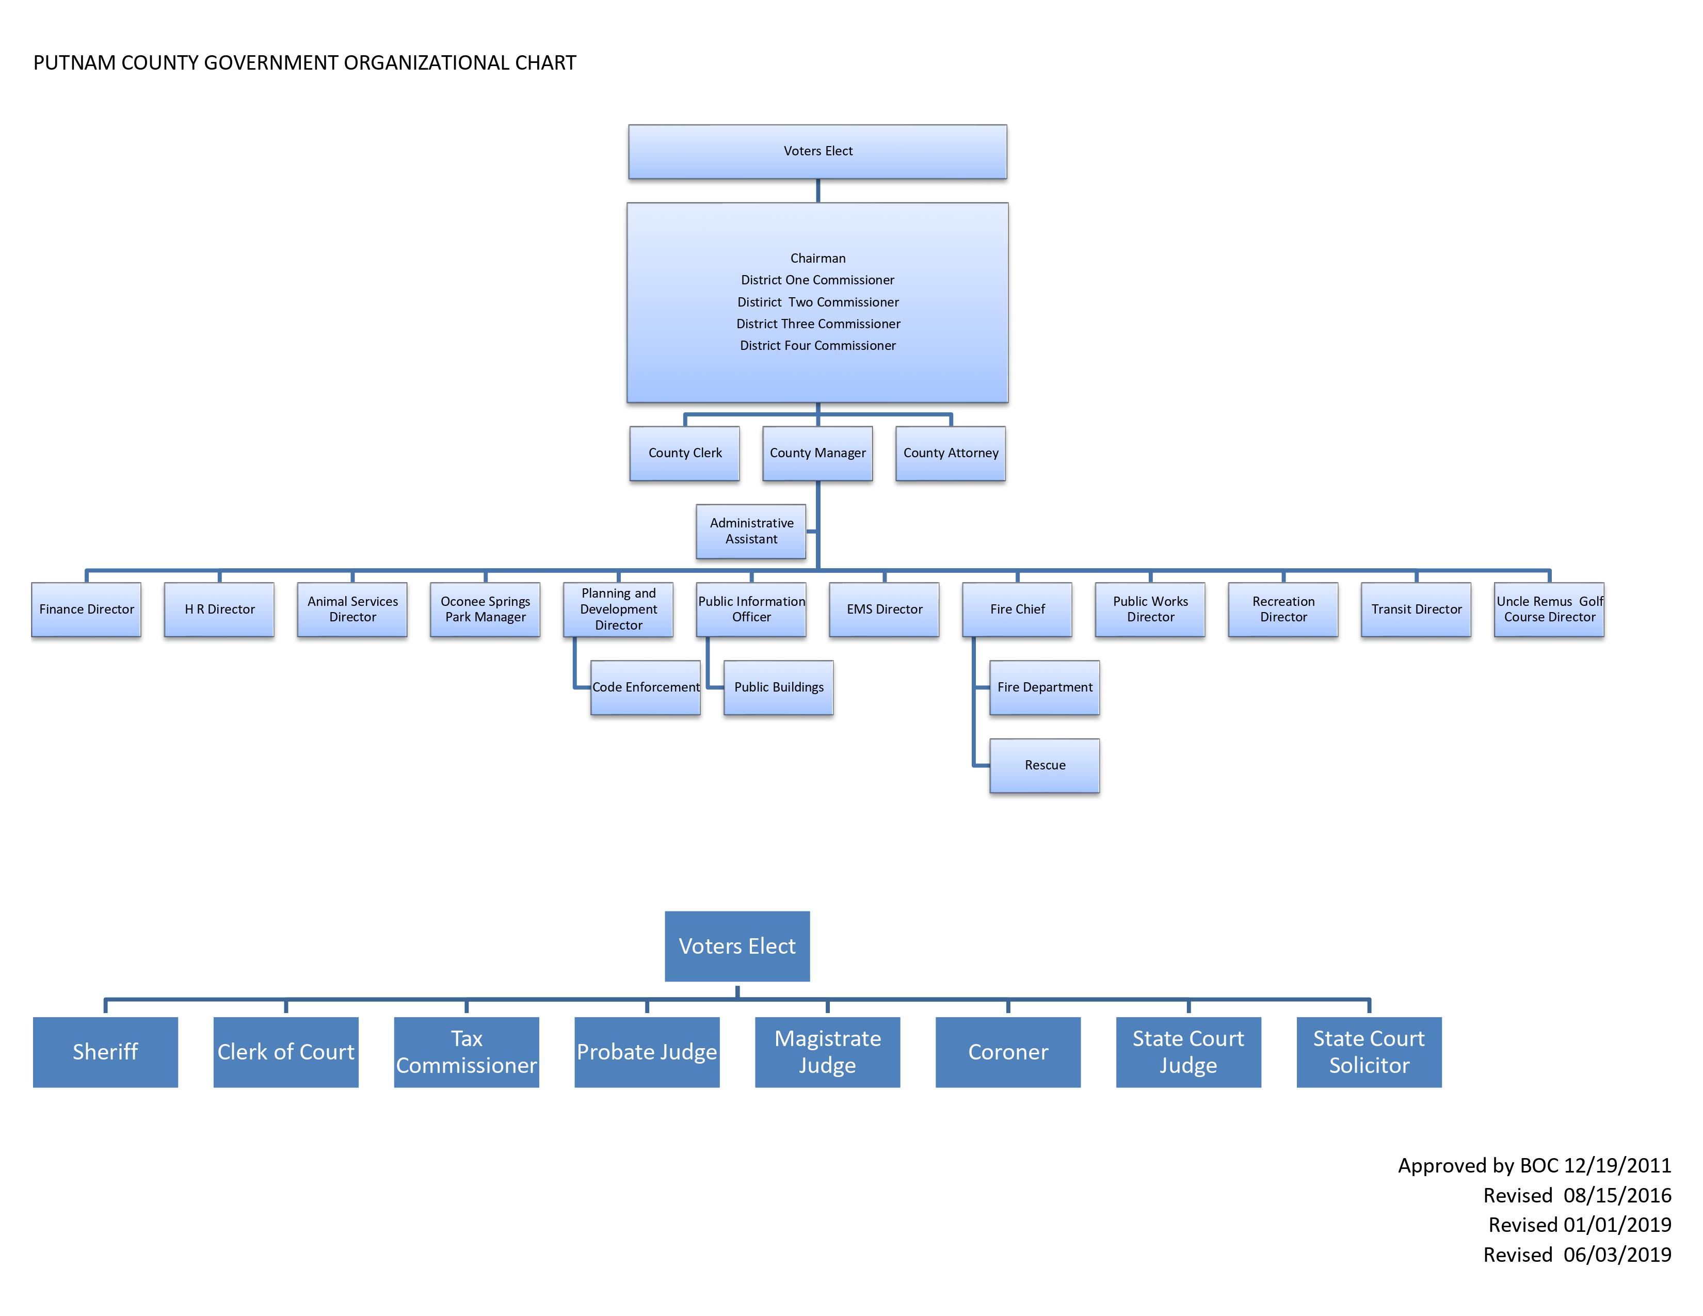

Slide 10
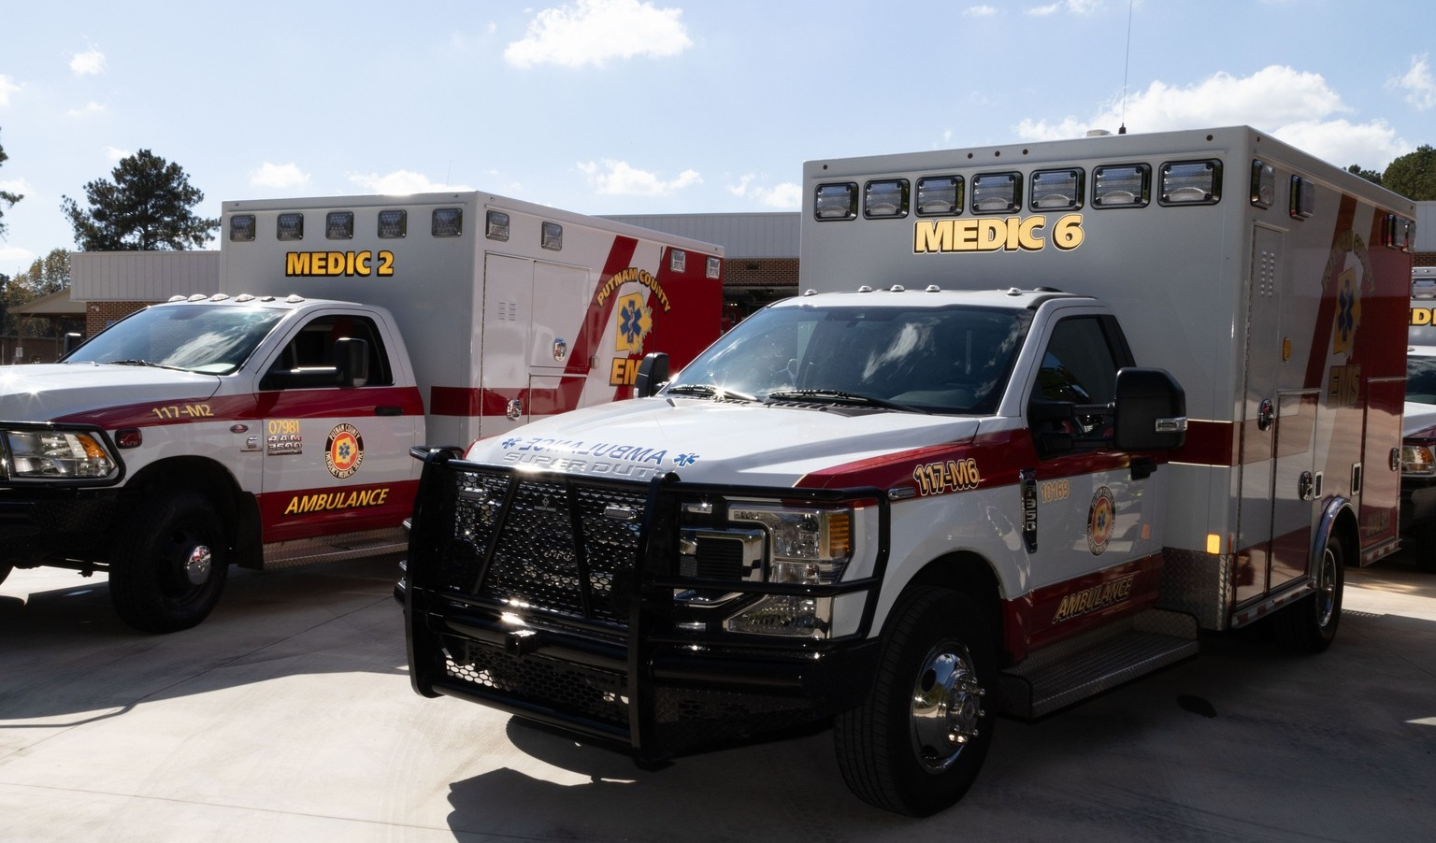
Putnam County EMS
In FY ’24, Putnam County EMS continued to provide the highest quality emergency care to Putnam County’s citizens. The team responded to a total of 3,084 calls in FY ’24, which is 153 less calls than last year. The majority of these, represented by the graph above were as follows: 528 calls to assist sick persons (fever, body aches, general malaise), 330 falls, 260 calls for breathing issues, and 343 calls to provide care for traffic accident injuries. Putnam EMS responded to 282 calls for patient transfers to medical facilities.

Slide 11
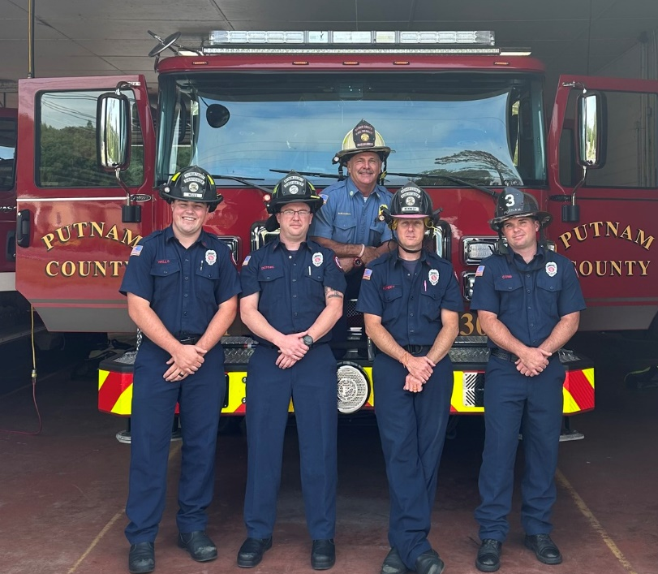
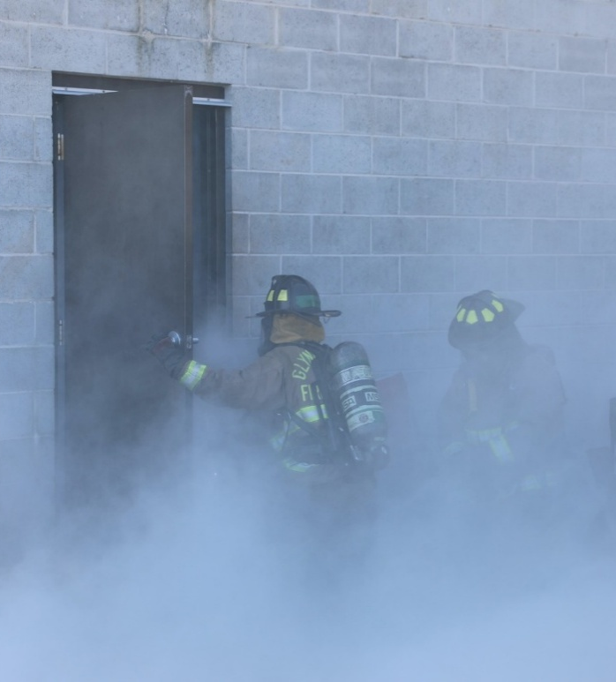
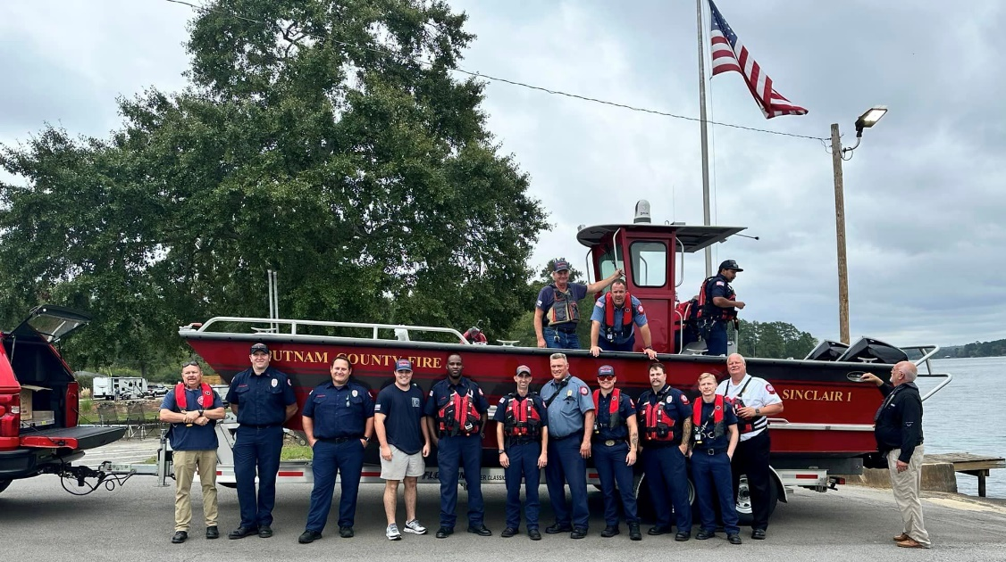
Putnam County Fire Rescue
In FY ‘24, Putnam Fire-Rescue responded to a total of 2,500 calls, which is 144 more calls than the previous year. The chart on the right provides data for those calls. 1,458 calls were to provide Rescue & Emergency Medical Services. 164 calls were for Fires, 449 calls were service calls, 208 calls were classified as good intent, and 136 calls were false alarm or false calls.

Slide 12
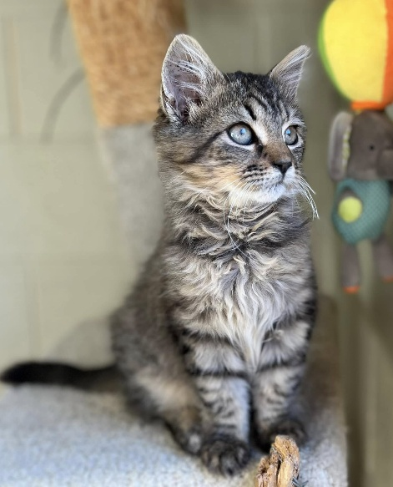
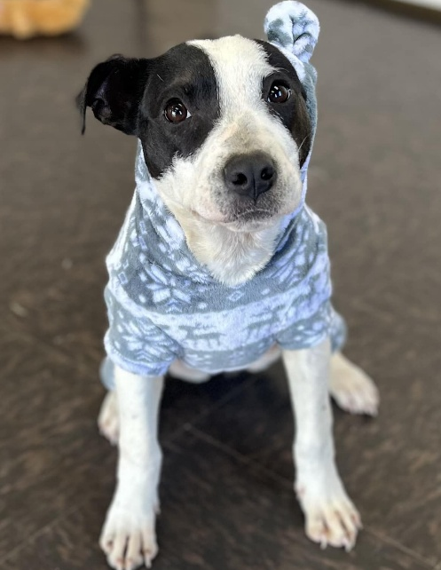
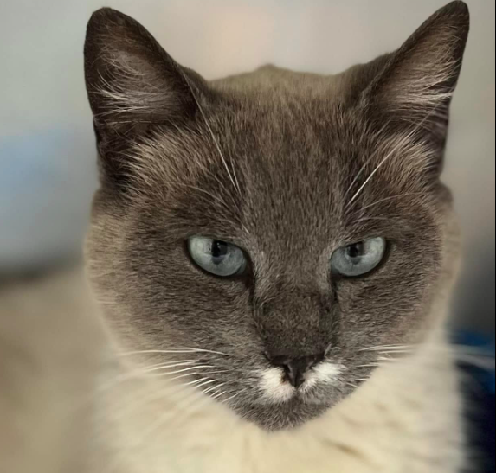
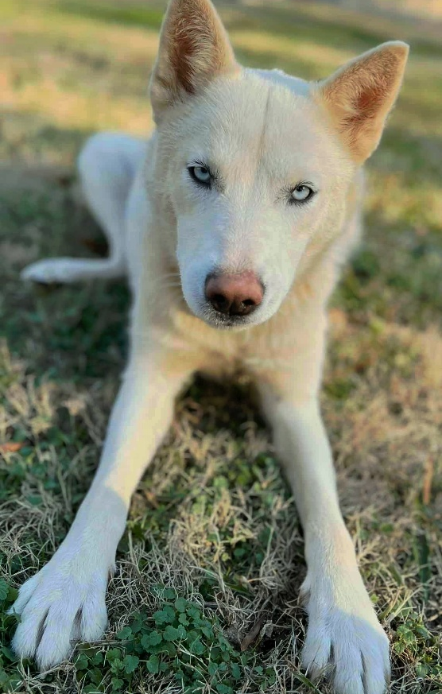
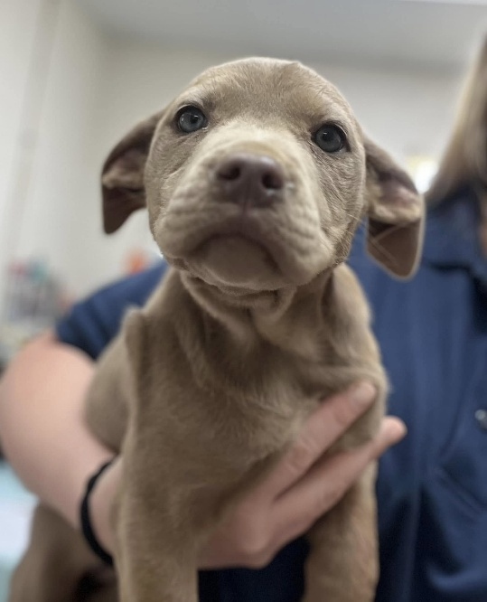
Animal Services
For FY ’24, Putnam County Animal Services took in a total of 430 animals, consisting of 252 dogs and 178 cats. Of those intakes, 41 dogs and 35 cats found their forever homes. If animals are not adopted, Putnam County Animal Services works hard to transfer the animals to non-profit rescues. In FY ‘24, a total of 73 dogs and 19 cats were transferred to rescue.

Slide 13
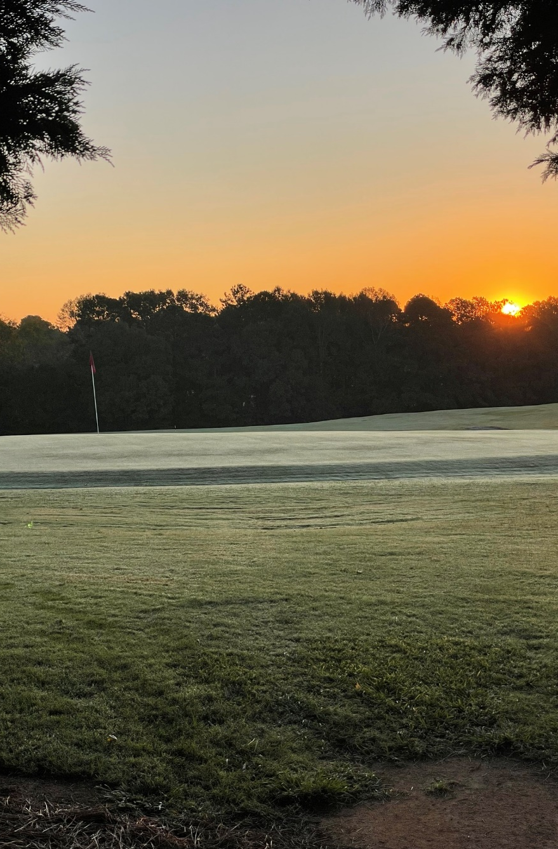
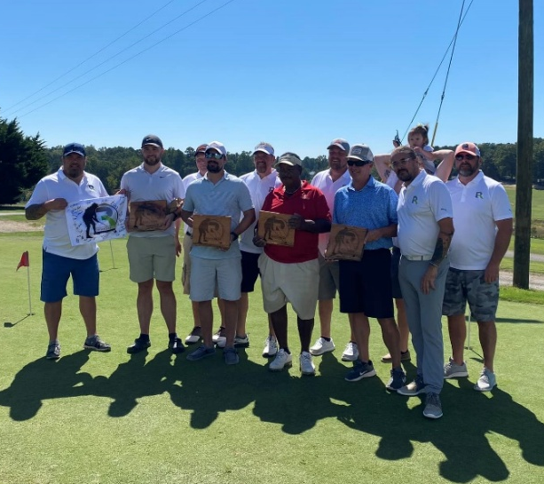
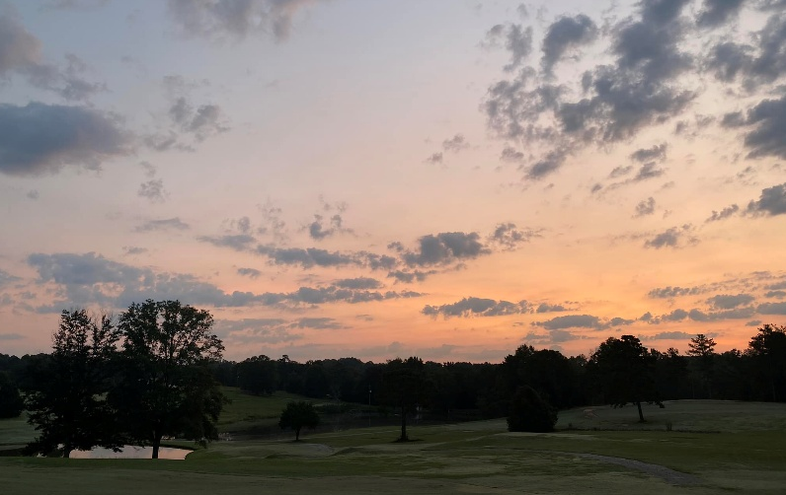
Uncle Remus Golf Course
In FY ‘24, Uncle Remus Golf Course saw another year of fantastic growth, player satisfaction, and community outreach! Over 7,500 players played 17,317 rounds of golf, a 11% increase from FY ‘23. In addition to regular play, the golf course hosted 3 fundraising tournaments which, all together, raised over $16,000 for charity, showing the power of our citizens to come together and give back to their county. Uncle Remus Golf Course hosted the Georgia State Golf Association Junior Tour for 2 tournaments which saw more then 90 players and 200 spectators from all over the southeast come to Putnam County to test themselves against the course. The course was also the chosen location for the EPCOC Leadership 2024 group to provide the community with a free Easter Egg Hunt and fun day. The golf course continues to succeed in its mission to provide a place for the citizens of the county to come together, develop relationships, and create memories through the game of golf.

Slide 14
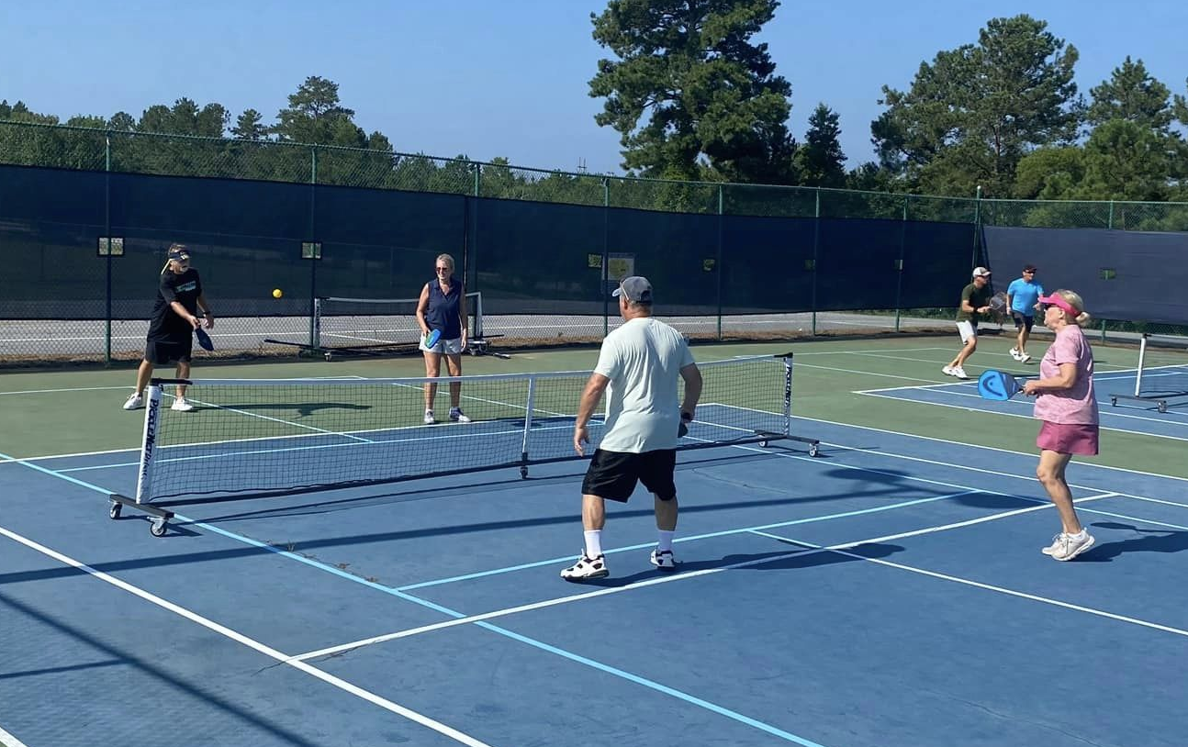

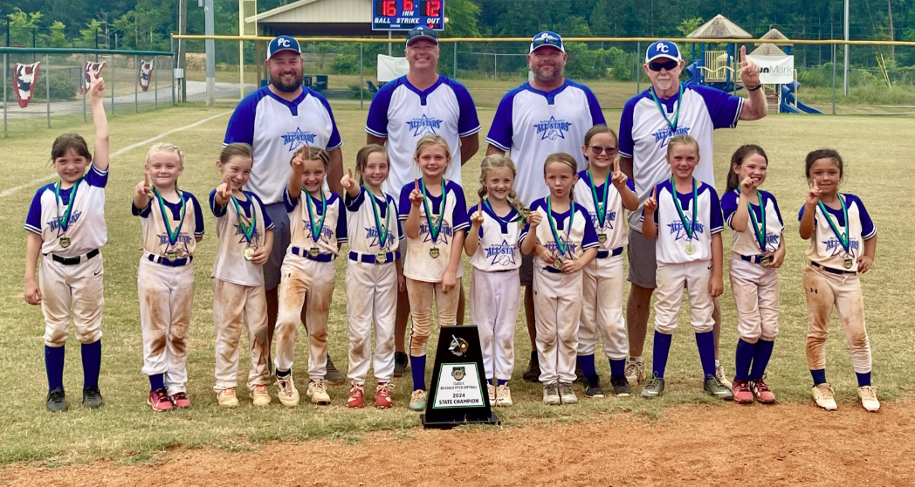
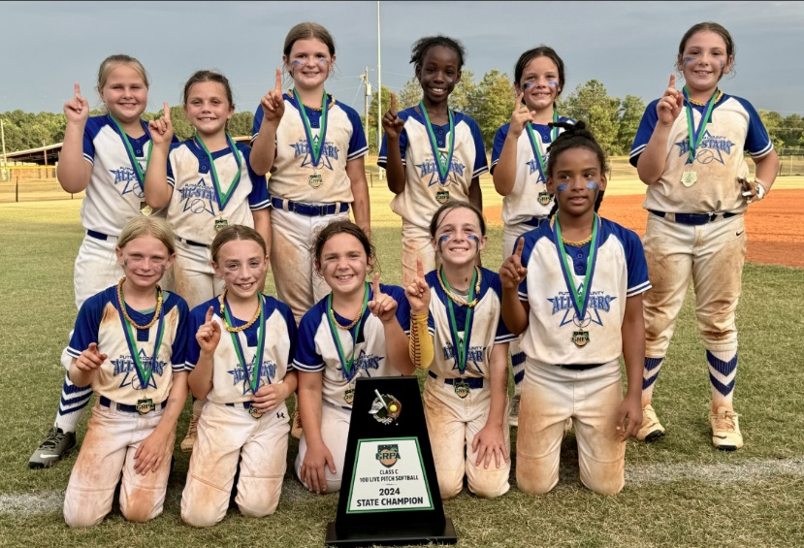
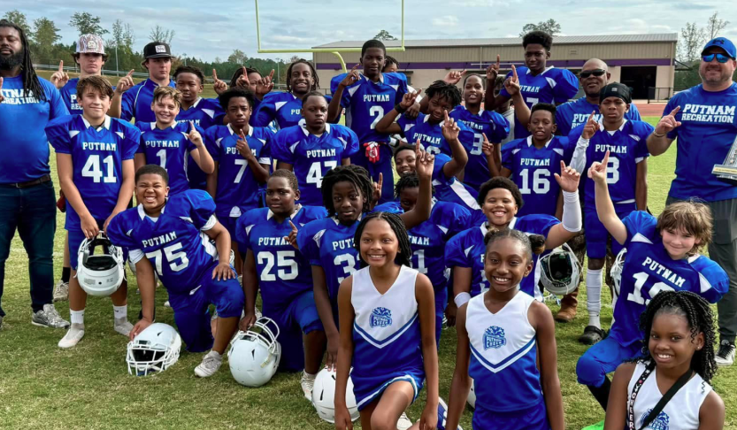
Putnam County Recreation
The Recreation Department has been busy creating opportunities for Putnam residents of all ages to become more active. By providing pickleball tournaments, church softball leagues, and recreational sporting events, we have witnessed many champions this year. Specifically, we want to congratulate the 2024 GRPA Class C 10U Girls Basketball State Champions, 2024 GRPA Class C 8U Girls Softball State Champions, 2024 GRPA Class C 10U Girls Softball State Champions, and 2024 Lake Area Football 11-12 Champions.

Slide 15
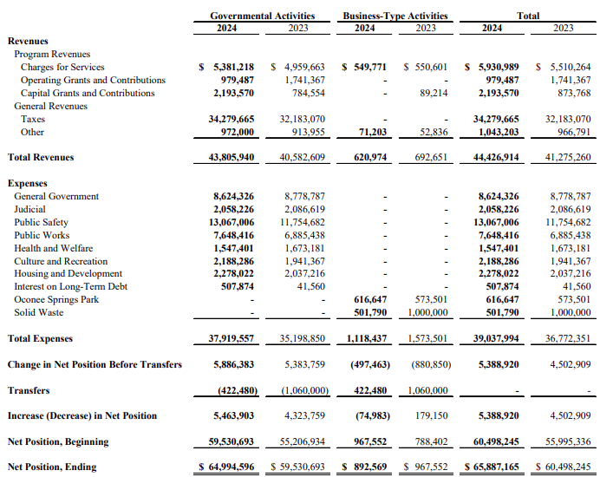
What was the county’s net position compared to FY 2023?
Putnam County’s Net Position
Net position refers to the county’s “bottom line” after all financial transactions have been reported. Therefore, a change in net position is the difference from one year to the next.
The table at the right provides a comparison for the changes in net position in governmental and business-type activities for the fiscal years ended September 30, 2024, and 2023.
At the end of FY ‘24, the County’s net position in governmental activities increased by $5.5 million, or 9.2%, primarily due to increased sales tax collections and grant revenues during FY ‘24. Net position in business-type activities decreased $74,983. The County’s overall net position increased $5.4 million from the prior year.

Slide 16
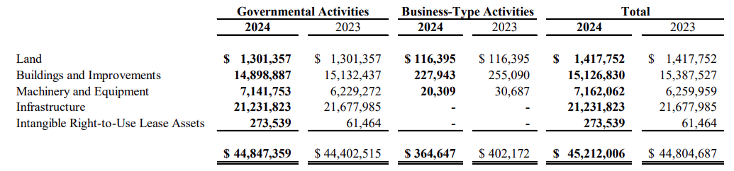
How is the county using its assets?
The County’s government-wide investment in capital assets, as of September 30, 2024, is $45.2 million. The schedule below summarizes capital assets used in both governmental and business-type activities at fiscal year-ends 2024 and 2023.
Major capital asset activities in the current fiscal year included the following:
A new fence at Jimmy Davis Park, new docks for the Fire Boats, a Pierce Fire Truck, and a Mack Truck with Asphalt Distributor.

Slide 17
Glossary of Terms
Assets: Items of ownership. Assets can include cash, stock, land, buildings, machinery, furniture, and other equipment. There are several categories of Assets:
Capital Assets: Assets of a long-term character (beyond the current year) that are intended to continue to be held or used, such as land, buildings, vehicles, machinery, furniture, and other equipment.
Net Position: The difference between (a) assets and deferred outflows of resources and (b) liabilities and deferred inflows of resources.
Restricted Assets: Assets that may not be used for normal operating purposes because of the requirements of regulatory authorities, provisions in bond contracts, or other legal agreements, but do not have to be accounted for in a separate fund.
Unrestricted Assets: Funds established to account for assets or resources that may be utilized at the discretion of the Board of Commissioners.
Expenditures: Government purchases which can be financed by revenue and/or government borrowing, i.e. bonds, tax anticipation, notes, etc.
Fund Balance: The portion of fund revenue over expenditures available for use.
General Fund: A fund used to account for the ordinary operations of the County government that are financed from taxes and other general revenue.
Liabilities: Future spending of revenue as a result of past transactions and other past events. Liabilities are reported on a balance sheet and are divided into two categories:
Current Liabilities: These liabilities are reasonably expected to be liquidated within a year. They usually include payables such as wages, accounts, taxes, accounts payable, unearned revenue when adjusting entries, portions of long-term bonds to be paid this year, short-term obligations, and others.
Long-term Liabilities: These liabilities are reasonably expected not to be liquidated within a year. They usually include long-term bonds, notes payable, long-term leases, pension obligations, and long-term product warranties. In these liabilities, the County has to pay after a fixed period of time, usually longer than a year.
Revenue: Financial resources other than from interfund transfers and debt issue proceeds. Putnam County receives Revenue through property taxes, sales and other taxes, licenses and permits, grants, fines and forfeitures, charges for service, administration fees, investment income, and miscellaneous sources.

